Slide 1
BHS DANCE 2018-2019

Slide 2
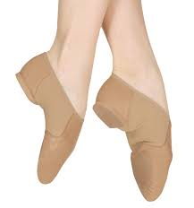
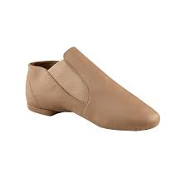
Dress Code
Jazz Shoes
Ballare
Center Stage
Discount Dance Supply
Dance Wear Solutions

Slide 3
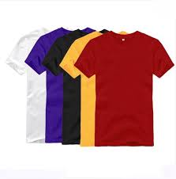
Dress Code
T-shirt
Crew Neck

Slide 4
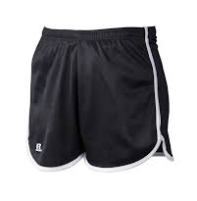
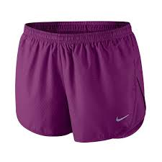
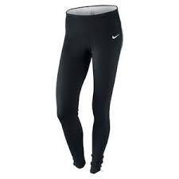
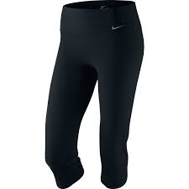
Dress Code
GIRLS
Athletic Shorts
Leggings/Yoga Pants/Tights must be worn underneath the athletic shorts.
Leggings/Yoga pants CAN NOT be worn by themselves
Sweatpants

Slide 5
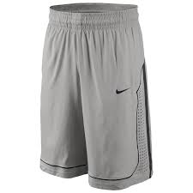
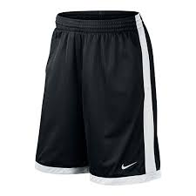
Dress Code
BOYS
Knee length athletic shorts (basketball style shorts)
Sweatpants

Slide 6
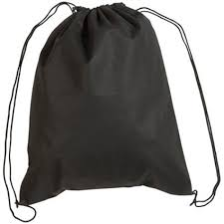
Dress Code
Book bags are NOT allowed. Students should bring their change of clothes in a drawstring bag.

Slide 7
Beginning of Class
Students will change for class in the provided dressing rooms
Students will have 3 minutes after the bell rings to finish changing
with the exception of 1st period
Students will quietly begin to stretch/warm-up for class while the teacher takes attendance

Slide 8
Class Expectations
Be in Dress Code
3 warnings
4 or more times not dressed out - DETENTION
Be responsible and focused
Be an active participant
Be respectful
Approach class and assignments with enthusiasm
Prepare outside of class (in addition to rehearsals)
No Food, drink, or GUM
Bottled water is acceptable
Students will need to bring a pencil and notebook to class

Slide 9
Injuries
If a student is injured or sick and is unable to participate in class, he/she will receive a daily assignment to go along with the day’s lesson.
If a student is injured for an extended period of time (more than 3 days) the teacher will work with that student on a prolonged written assignment.
A DOCTOR’S NOTE IS REQUIRED

Slide 10
End of Class
Students will receive the last 5 minutes of class to change before the end of class bell
with the exception of 7th period.

Slide 11
Performances
Dancing With the Wolves (Buford Dance Fundraiser)
Saturday September 22, 2018
Community Holiday Concert (Advanced Dance ONLY)
Thursday November 29, 2018
Dance Concert
Friday & Saturday January 25 – 26, 2019
Student Choreography Showcase (Intermediate and Advanced Dance ONLY)
Tuesday April 23, 2019
Rehearsal Schedule will be published online SOON!
Students must notify Mrs. Smith immediately of any rehearsal conflicts. School related conflicts will be worked through on a case-by-case basis.
Rehearsals/Performances are for a grade and CAN NOT be made up

Slide 12
Dance Concert 2019

